Slide 1
RESPONDING TO HYDROGEN SULFIDE SUICIDES
AKA: DETERGENT SUICIDES

Slide 2
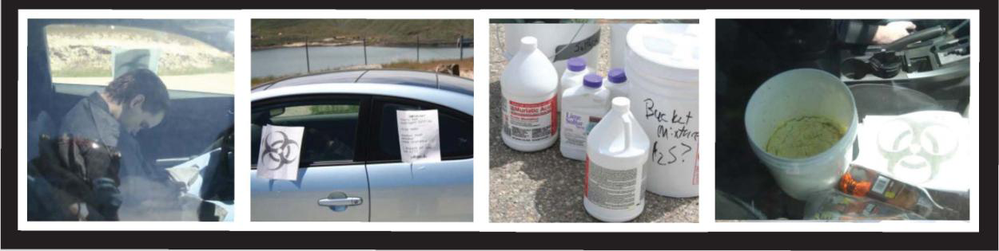
Typical Scenario

Slide 3
What is Hydrogen Sulfide?
Is considered a poison that effects several systems of the body, especially the nervous system.
Is similar to cyanide.
Is colorless, flammable, extremely hazardous gas.
Smells like rotten eggs.

Slide 4
Typical Ingredients
Acid sources consist of toilet bowl cleaners, shower cleaners, tile cleaners & ready to use disinfectants.
Sulfide sources consist of pesticides, dandruff shampoos, garden fungicides & spackling paste.
The Japanese version uses bath sulfur which is similar to bath salts.

Slide 5
Hydrogen Sulfide suicide or detergent suicide was first reported in the United States in Pasadena, CA in 2008. It has since moved east with cases reported in Utah, Idaho, Carolinas, Texas, Georgia and as far north as Connecticut. Detergent suicides first started in Japan and has rapidly spread in popularity by means of the internet.

Slide 6
Suicide is the eleventh most common cause of death. This type of suicides claims mostly young adults. Almost four times as many males die from suicide than females. Approximately 13 % of men and 40 % of women who commit suicide choose poison such as hydrogen sulfide as their method.

Slide 7
Primary Route of Exposure
Inhalation in a gaseous state however, contact with the liquid can cause frost bite.
Has an auto-ignition point of 500 degrees Fahrenheit (cigarettes burn at 1400 degrees)
Burns with a blue flames and can cause chemical pneumonia within hours.

Slide 8
Exposure
Low concentrations ( 0 – 10 ppm) cause eye irritation, sore throat, cough, nausea, shortness of breath and fluid in the lungs.
Moderate concentrations (10 – 50 ppm) cause fatigue, loss of appetite, vomiting, staggering, headaches.
High concentrations (50 – 200 ppm) cause convulsions, seizures, amnesia, coma and death.

Slide 9
Labored breathing occurs shortly after the gas in inhaled and respiratory paralysis soon follows. Death will occur by asphyxiation unless the victim is removed immediately to fresh air and resuscitated.

Slide 10
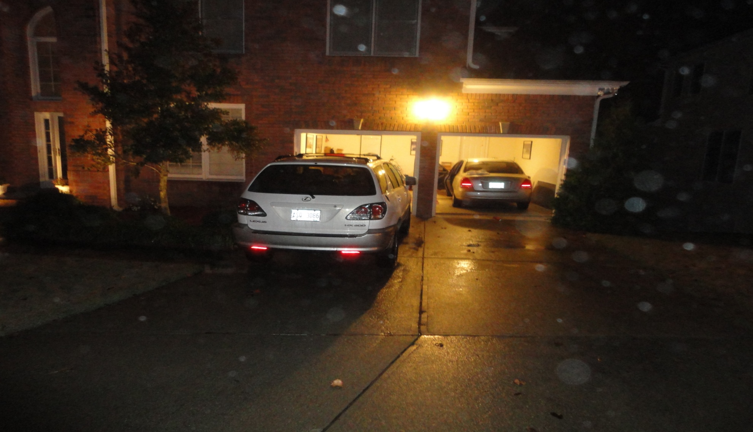
Douglas County Georgia 11-30-10

Slide 11
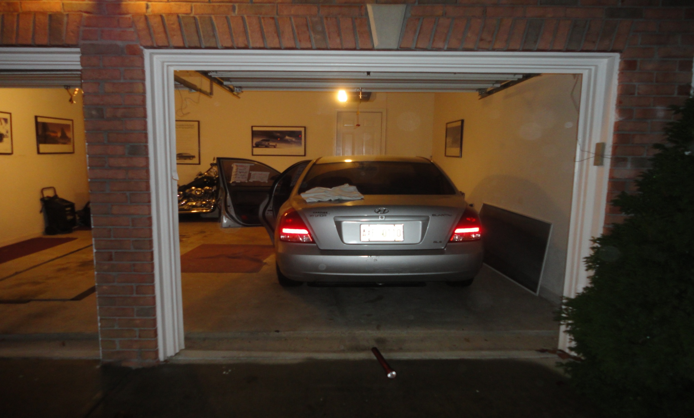
Vehicle Victim Was Located In

Slide 12
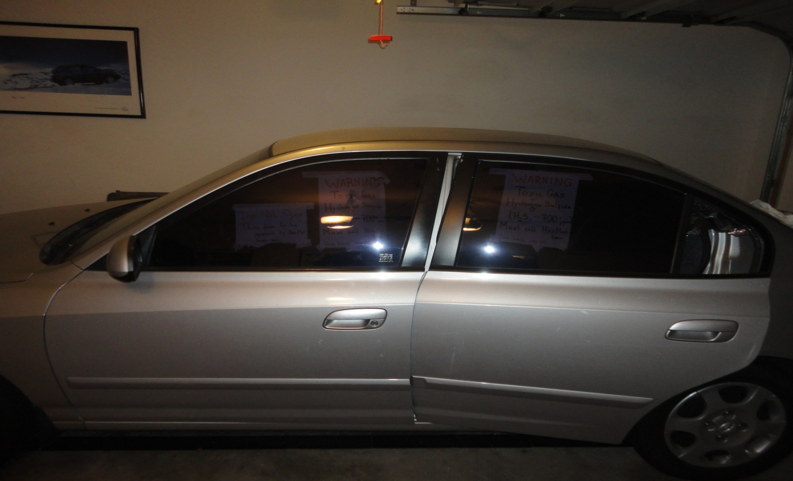
Note The Warning Letters Left In Windows

Slide 13
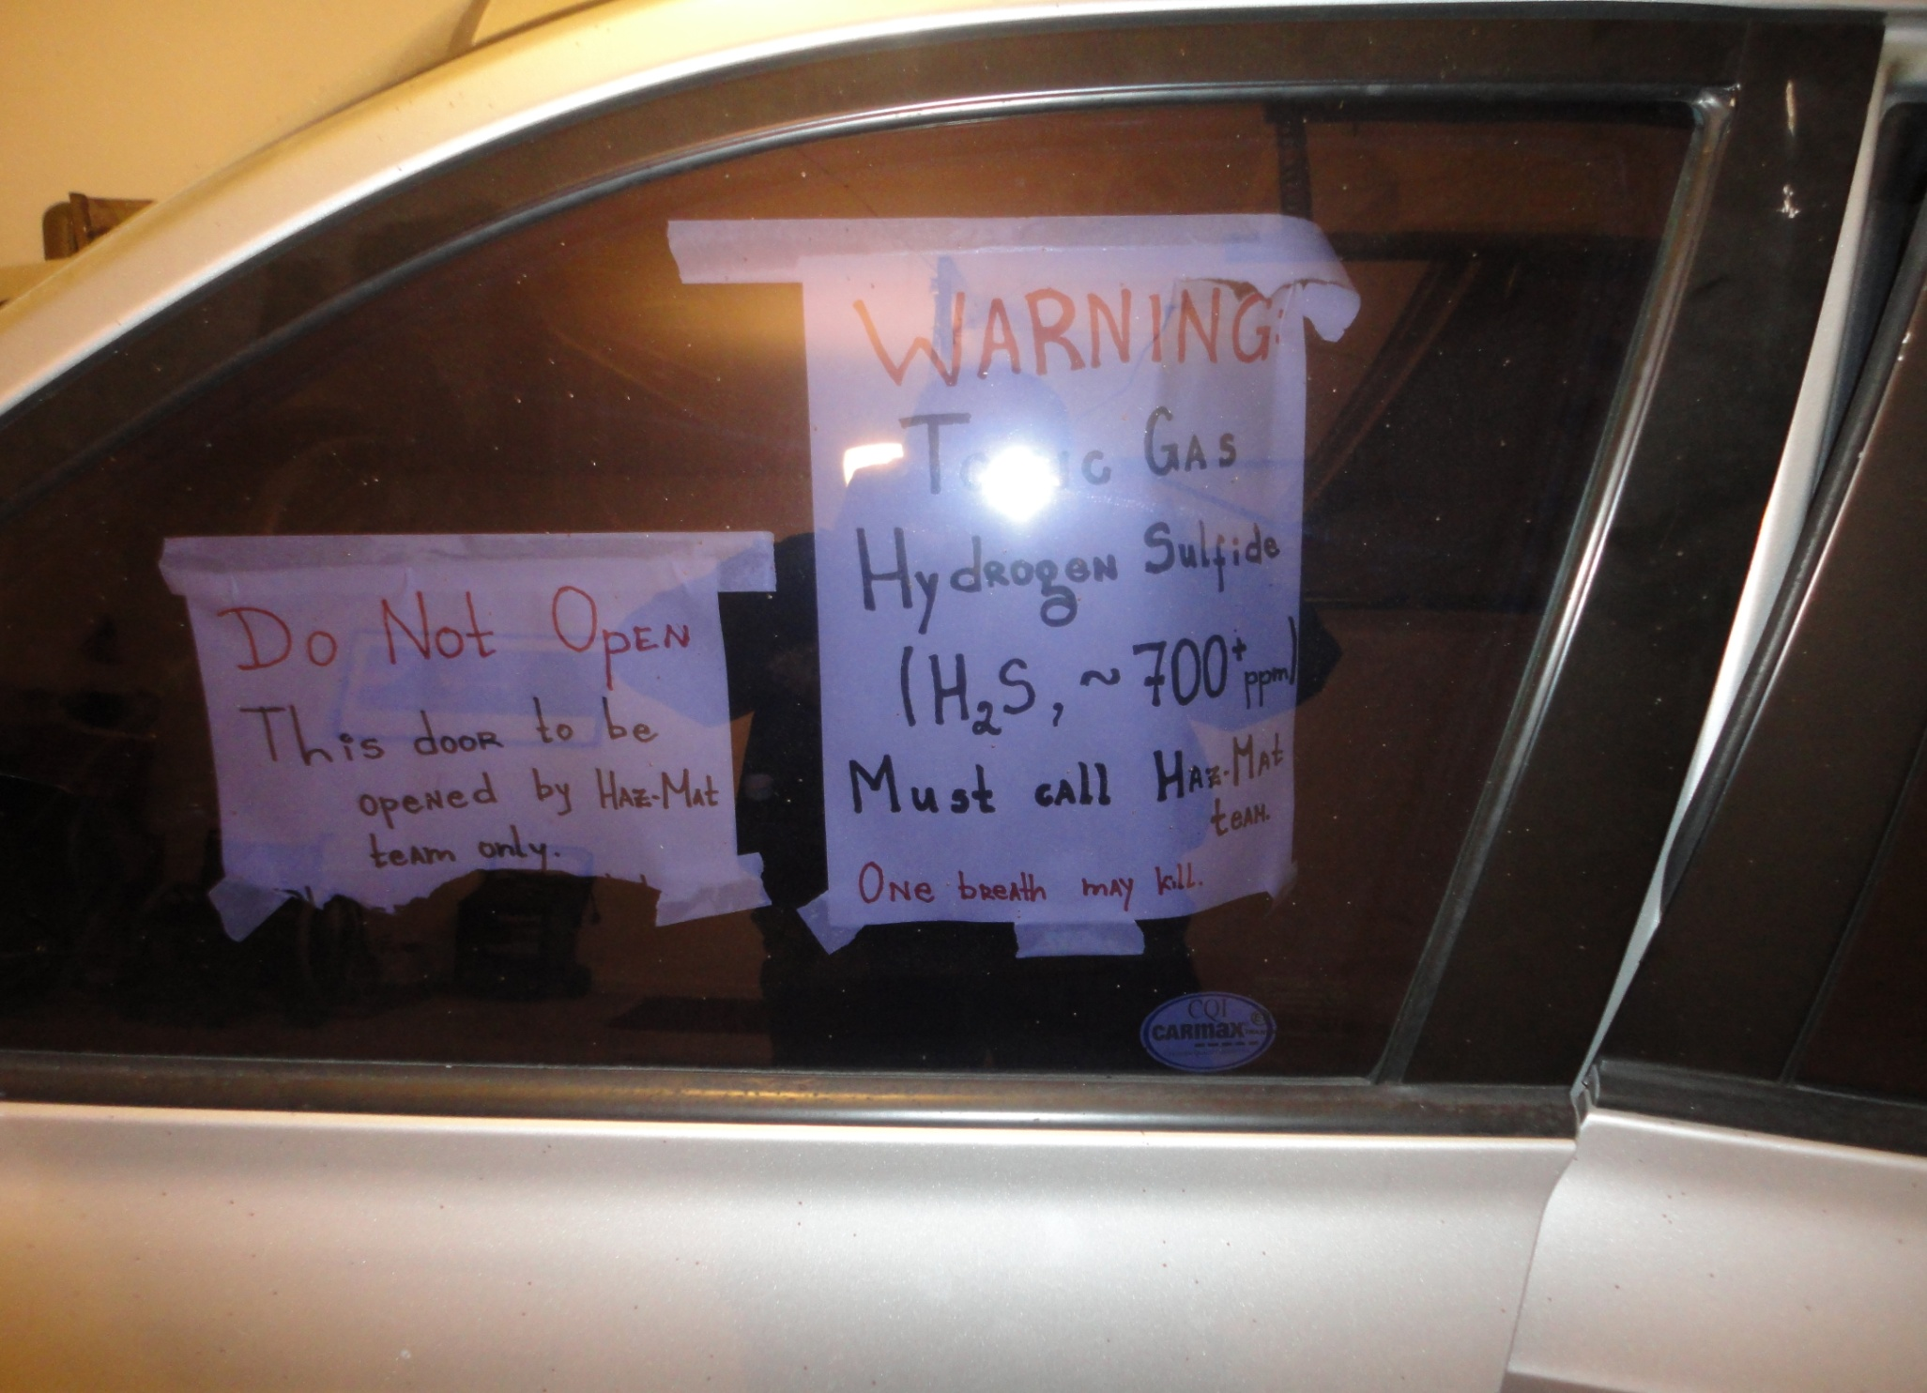

Slide 14
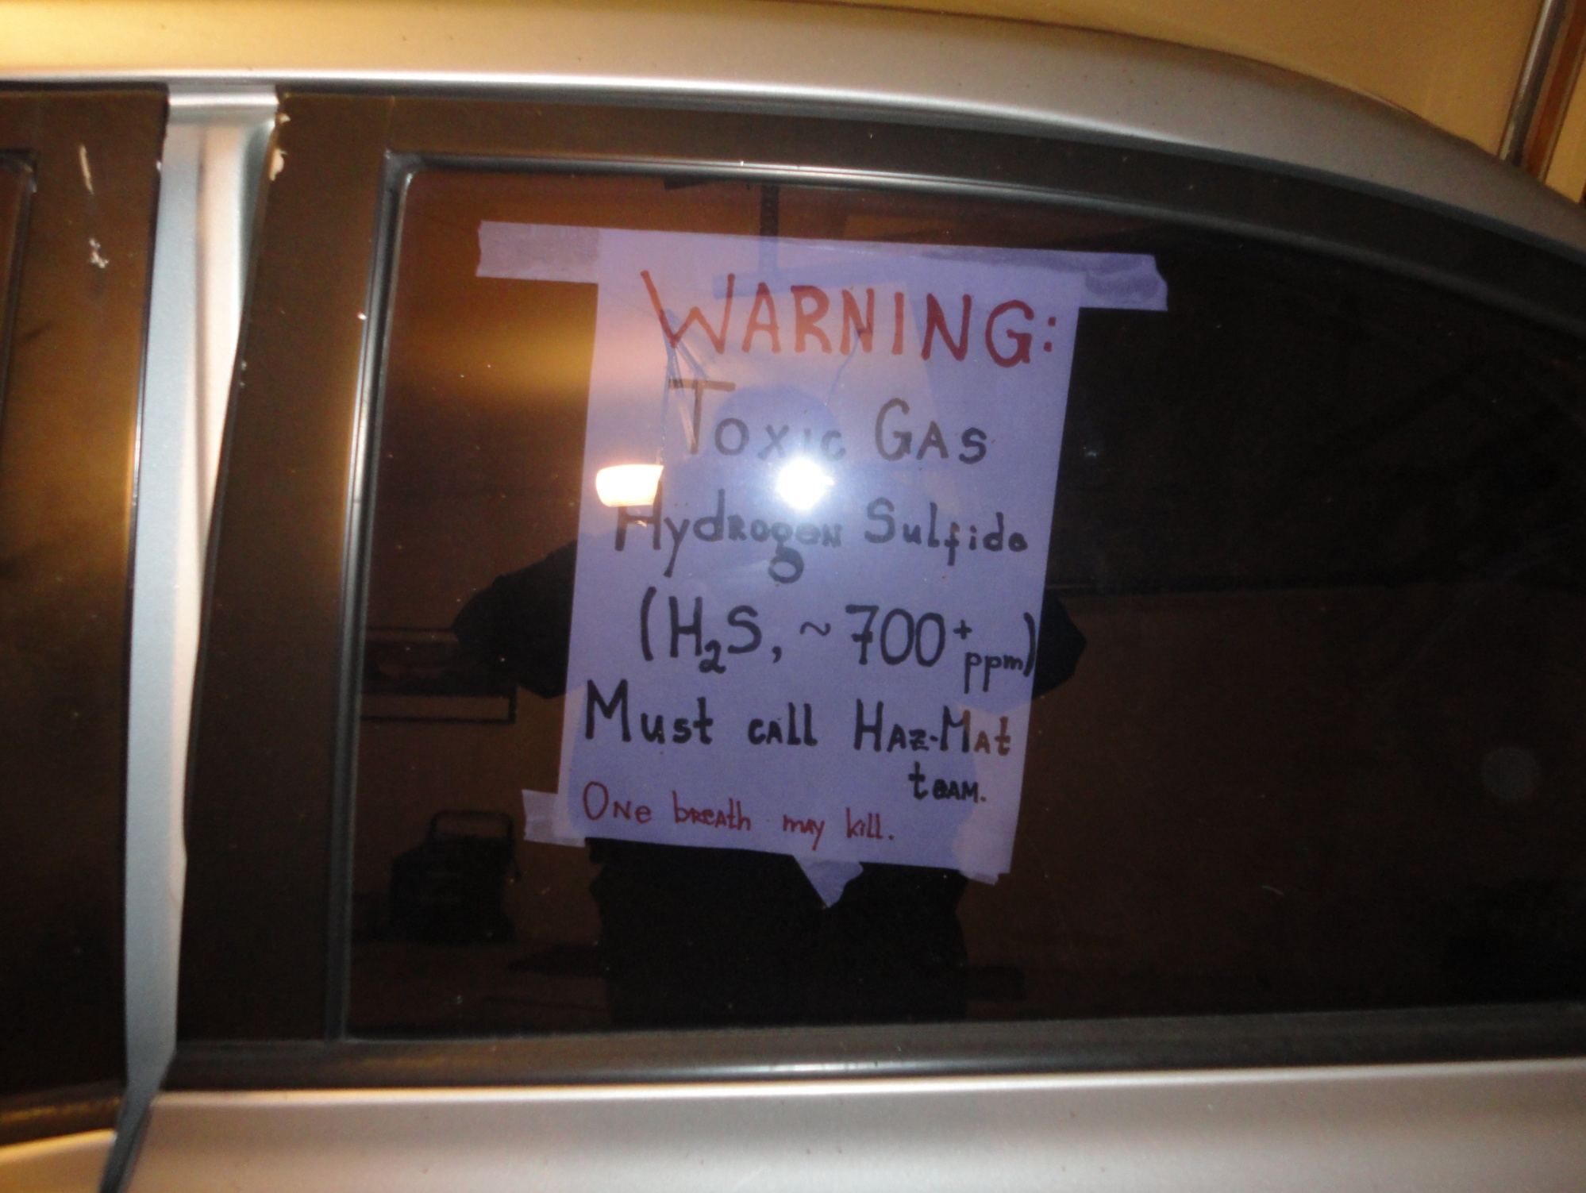

Slide 15
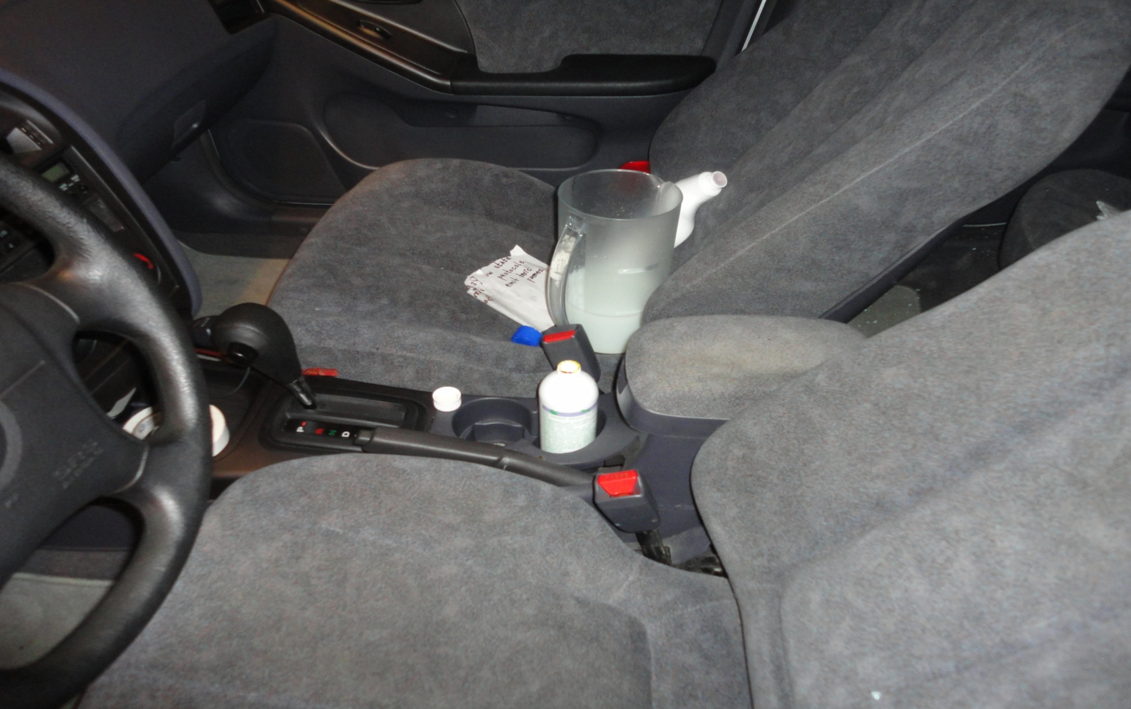
Hydrogen Sulfide Cocktail Mixture

Slide 16
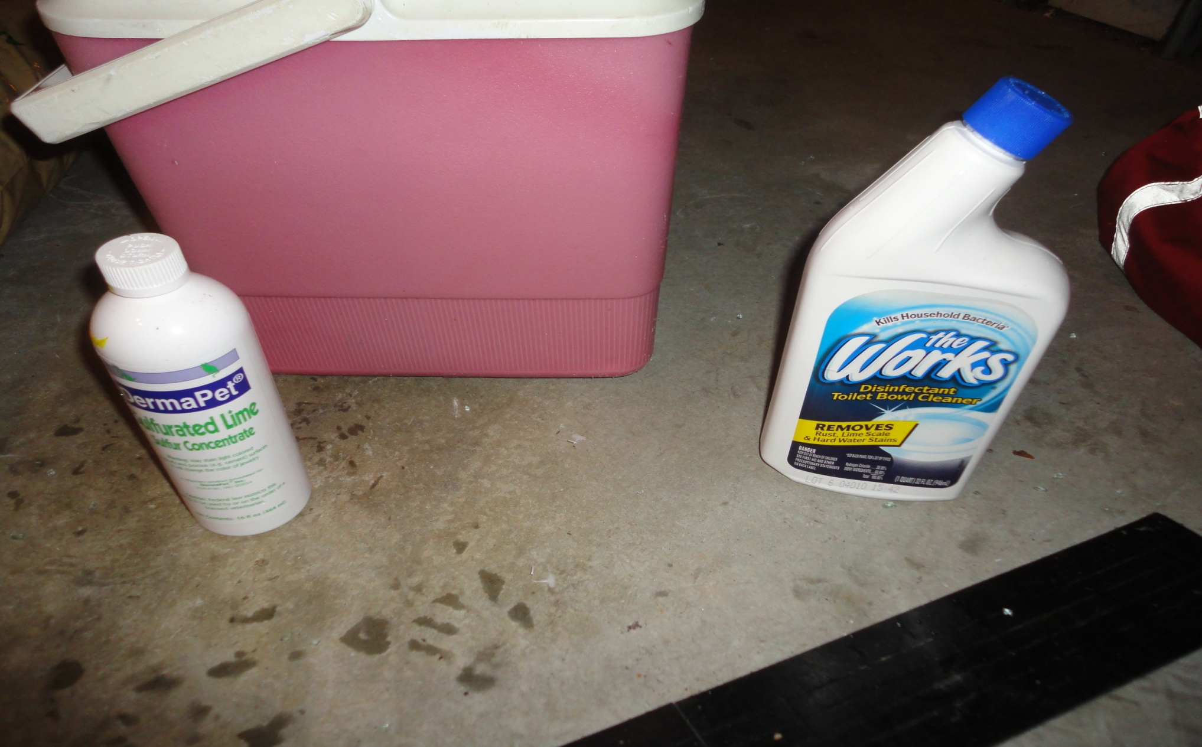
Chemicals Used

Slide 17
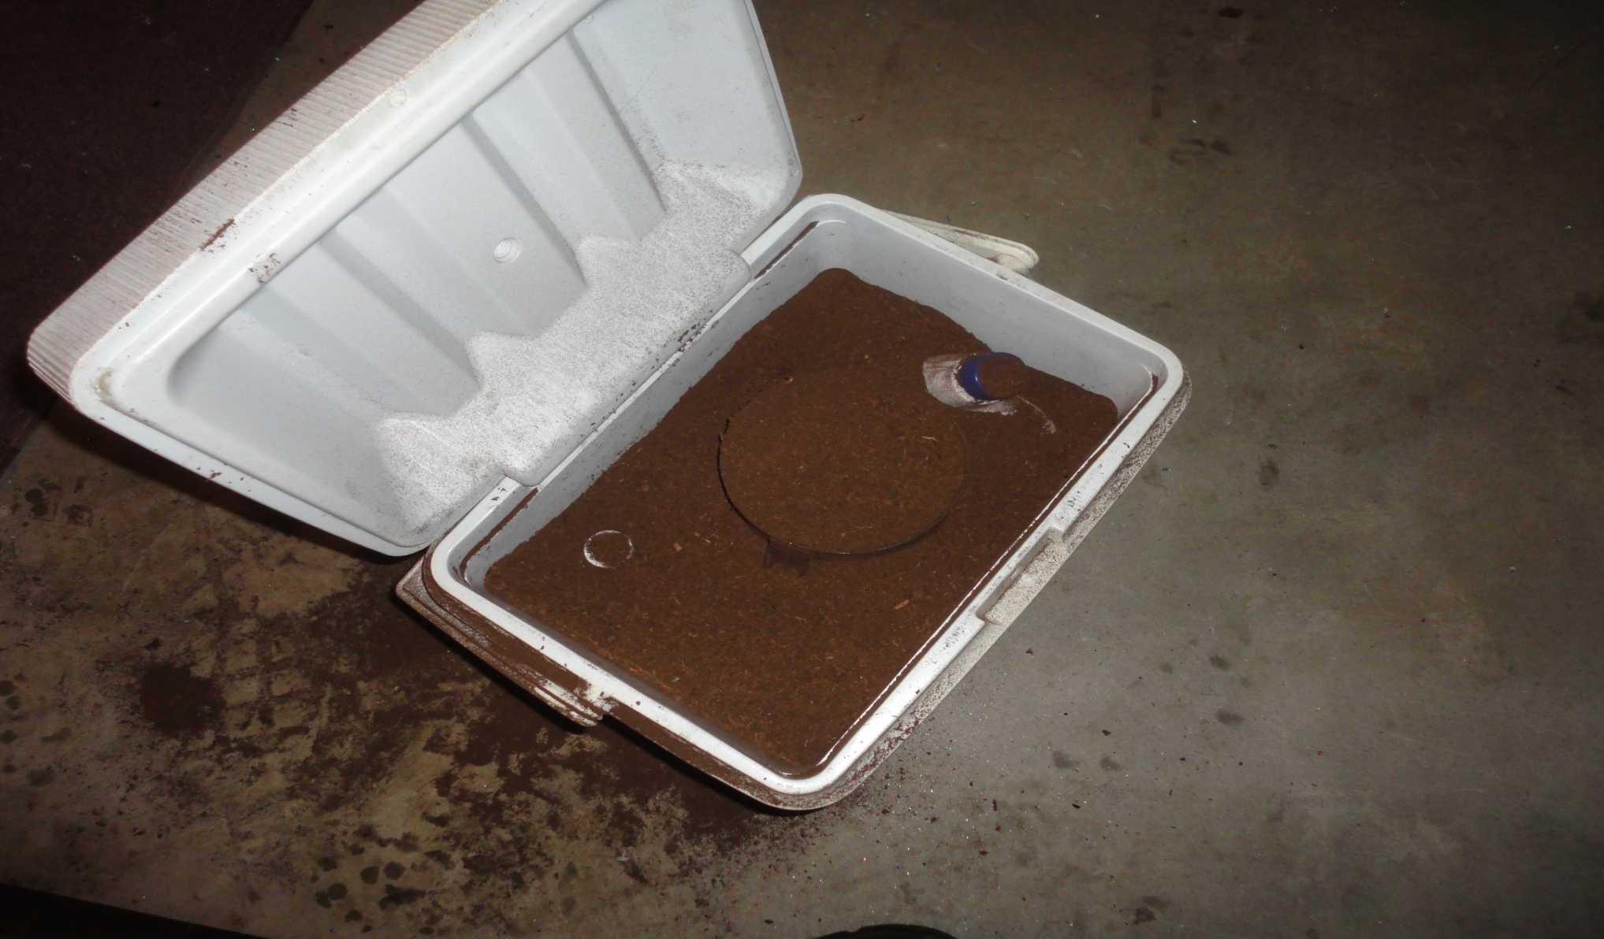
Stabilizing Using Inert Material

Slide 18
How To Approach The Incident
Survey the scene.
Establish a “hot” zone.
Do not rely on your sense of smell in a H2S incident because your ability to smell may be lost within 3 – 5 minutes of exposure.
Determine if you have proper PPE (SCBA). If not, call for Haz Mat team.
If so, put on your PPE, safely remove victim to fresh air.

Slide 19
Exposure Treatment
Remove victim from “hot” zone and up wind from incident. If rescuer has been exposed you are considered contaminated remove any clothing contaminated by liquid H2S. Do not walk out of the “warm” zone until directed. You must be decontaminated.
After removing the victim to fresh air asses vitals .
Begin CPR if indicated.
Have victim transported to hospital for further evaluation and treatment.

